Slide 1
Validating your work: Benefits & take-aways in 1:1
Rachel Appleby
BESIG Malta, November 2024
https://rachelappleby.edublogs.org
www.linkedin.com/in/rachelappleby18
@rapple184.bsky.social

Slide 2
BESIG – so far:
💭
What’s one of your take-aways so far from one BESIG talk?
Is that what you expected from the talk?
Do you think it ties in with the presenter’s aims?
Have you told anyone?
Did you tell the speaker?

Slide 3
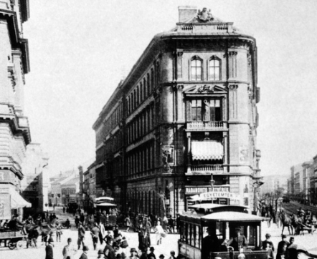
1:1 Take-aways: “The unexpected!”
Rob – linking sounds before / between vowels
... the Audiovisual Archive in Hungary […]
They have to add .. .
“Here is this picture: we know it’s somewhere in Budapest, and – at a guess – it’s 1930s.”
– at_a guess –
/y/
__
__
/w/

Slide 4
Why does this matter?

Slide 5
Expectations – your students’
What do 1:1 students take away from your classes?
Are the benefits always linguistic?
Do you know? How?
Do you ask?
Do they tell you?

Slide 6
Your students: what do they bring?
Stories
Questions
A problem
?

Slide 7
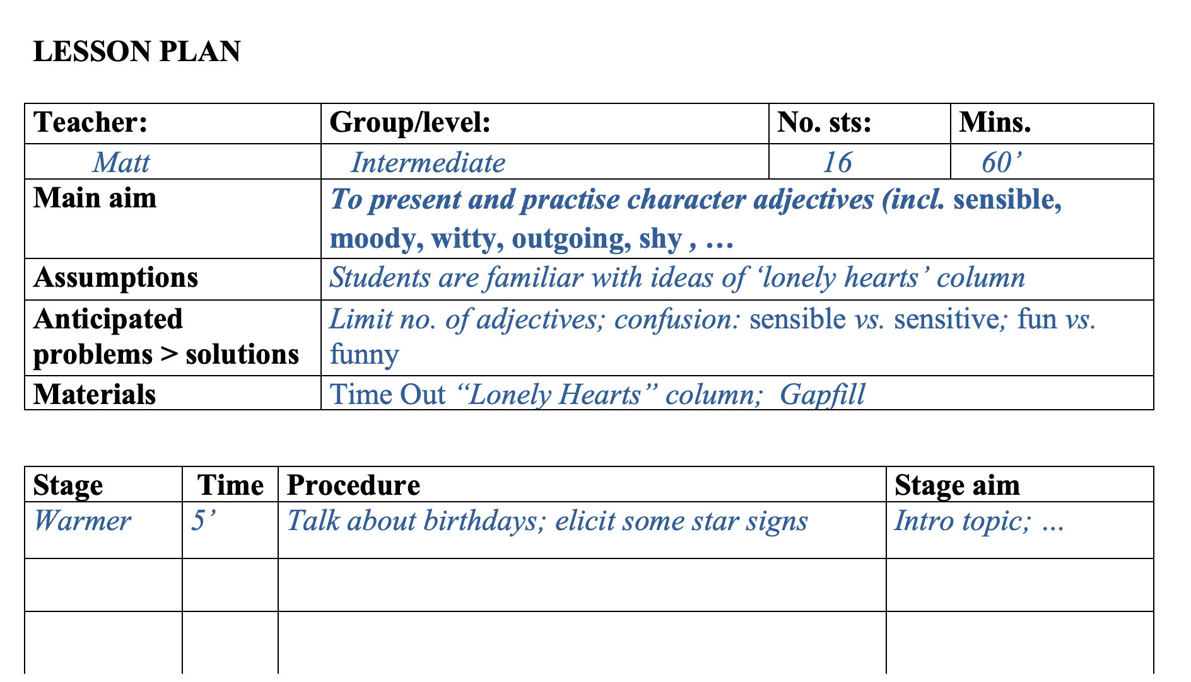
Group vs. 1:1 teaching
“By the end of the lesson, students …”
• flexibility
• respect
• authenticity
Carl Rogers (1994):
3 core characteristics for creating an effective learning environment
Notes:
1:1. Volatile. Immediate. Exciting. Alive. Live. Authentic BUT: Dangerous. On the spot. Risky.

Slide 8
Approaches
• flexibility
• respect
• authenticity
ARC
Magic moments
3 ingredients
The jungle
Go with the flow
Prepare

Slide 9
Scrivener
• flexibility
• respect
• authenticity
1. A.R.C.
Authentic use
Restricted use
Clarification
“
[…] a means to examine the different stages in a lesson and evaluate them in terms of what the students get out of them.
… every lesson should have an appropriate balance of activities
ARC

Slide 10
Scrivener
• flexibility
• respect
• authenticity
2. Plan = Prepare thoroughly:
Relevant language points
Lesson sequences
Previous lesson notes
“
A plan is not a route-map of what must happen in class; it is only your best-informed / best-guess setting-up of some possibilities.

Slide 11
Harmer
/ Woodward
• flexibility
• respect
• authenticity
Jeremy Harmer: magic moments
Tessa Woodward: hijacks
Pleasant / unpleasant surprises = an opportunity

Slide 12
Davies
• flexibility
• respect
• authenticity
‘Go with the flow’
Be natural
Notice Student’s output
Appropriate decisions ‘on the hop’
Personal experience

Slide 13
Scrivener
• flexibility
• respect
• authenticity
3. The jungle:
“
Don't plan anything. […] Work entirely with what you find in the class.
Many teachers are surprised to come out feeling that they have taught particularly well – is this because they have had to listen and respond to students far more carefully than usual?

Slide 14
Approaches
• flexibility
• respect
• authenticity
ARC
Magic moments
3 ingredients
Go with the flow
The jungle
Prepare
My 30+30+30 rule

Slide 15
10 must-haves for 1:1
notes: previous lesson
3-column feedback sheet *
revision activity
questions
a “here & now” text
a recording device
Google docs to share
online dictionary
a feedback question / form
post-its / coloured pens / blank paper
My 30+30+30 rule

Slide 16
On-going feedback (T > S)
off-screen (columns 1+2)
Shared-screen – working on column 3
Language in columns 2+3 often become input for next time

Slide 17
3 cases studies:
1. Leo, pre-intermediate
Technician at Hungarian TV
> His weekend
2. Ali, upper-intermediate
Prep for a Fulbright scholarship to the US (Utah)
> Colleague’s visit
3. David, advanced Researcher in Neuroscience:
Budapest ELTE Univ.; Lyon; Univ. de Las Palmas
> ??
(pron.)
Look at each case study:
What take-home product could you define?

Slide 18
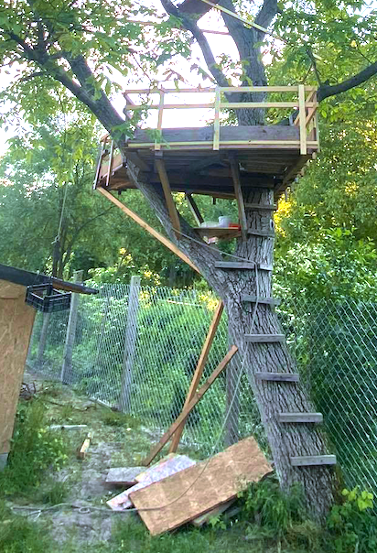
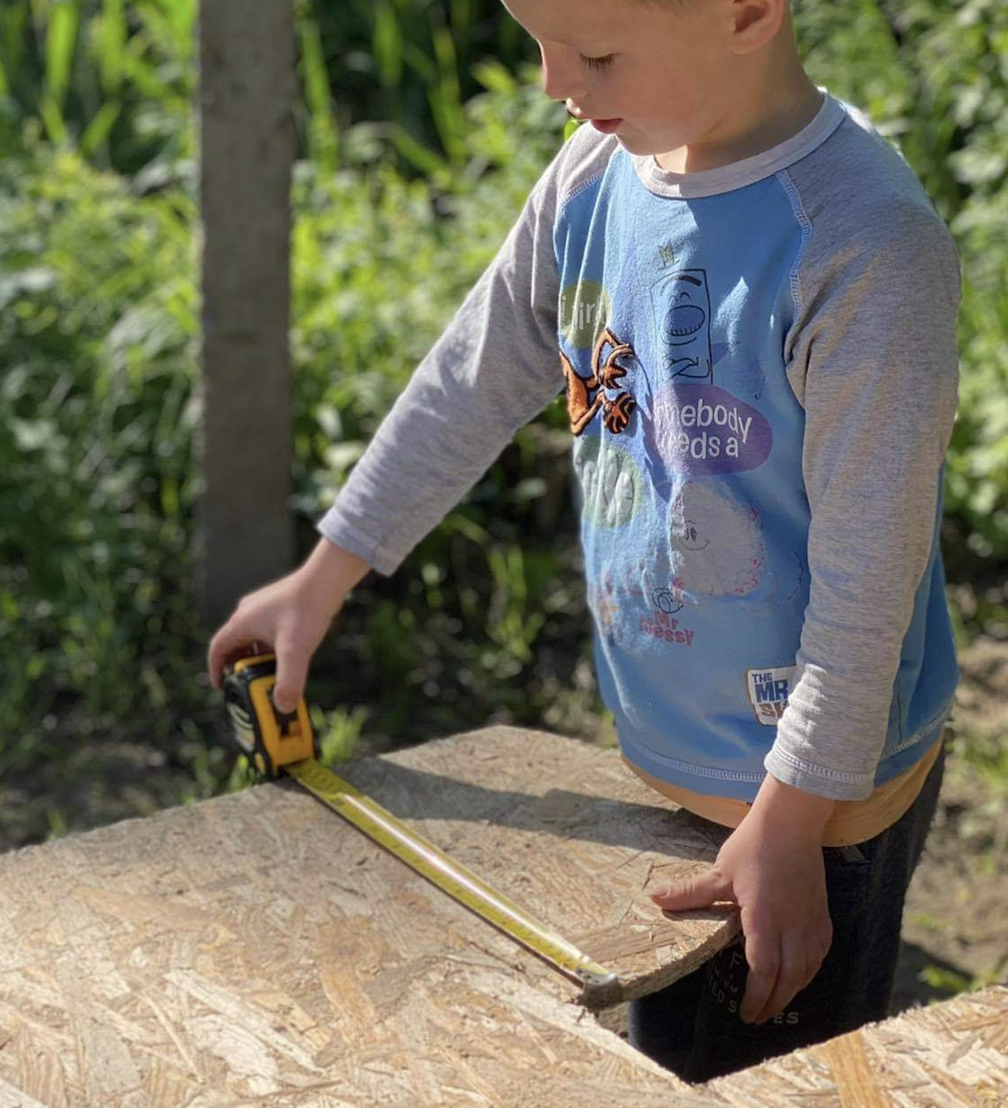
Leo – the lesson
T: Did you have a nice weekend?
S: Yes, I had. I play with children. We create a house in a tree!
T: A tree-house? You built a tree-house? With your children?
S. Yes. A tree-house. We build, we built a tree-house.
T. Wow! Is it easy to climb up the tree?
S. Oh yes. We make some stairs. T. Uh-huh. Steps? You made steps?
S. Yes, steps. We put pieces of wood, like steps on the tree. T. So first you made steps, then you made the tree-house?
S. Yes. One moment. I send um photos … on message.
T. Oh, it looks great. It’s very high!
S. Yes. And Ábel helps. He likes, um the centimetres.
T. Oh, nice!
S. So, and .. er next weekend we finish the tree-house.
T. Will you tell me more next time?

Slide 19
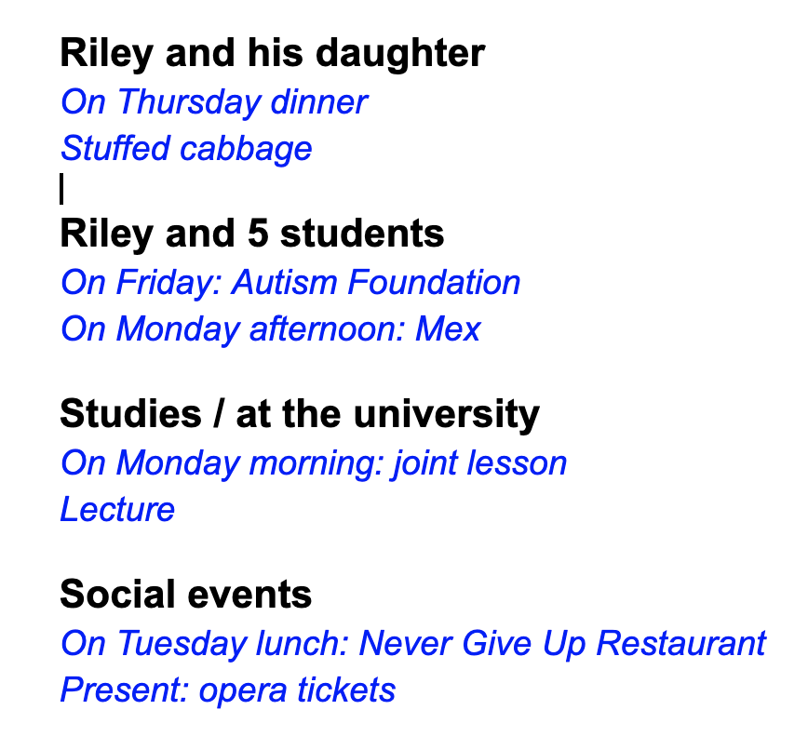
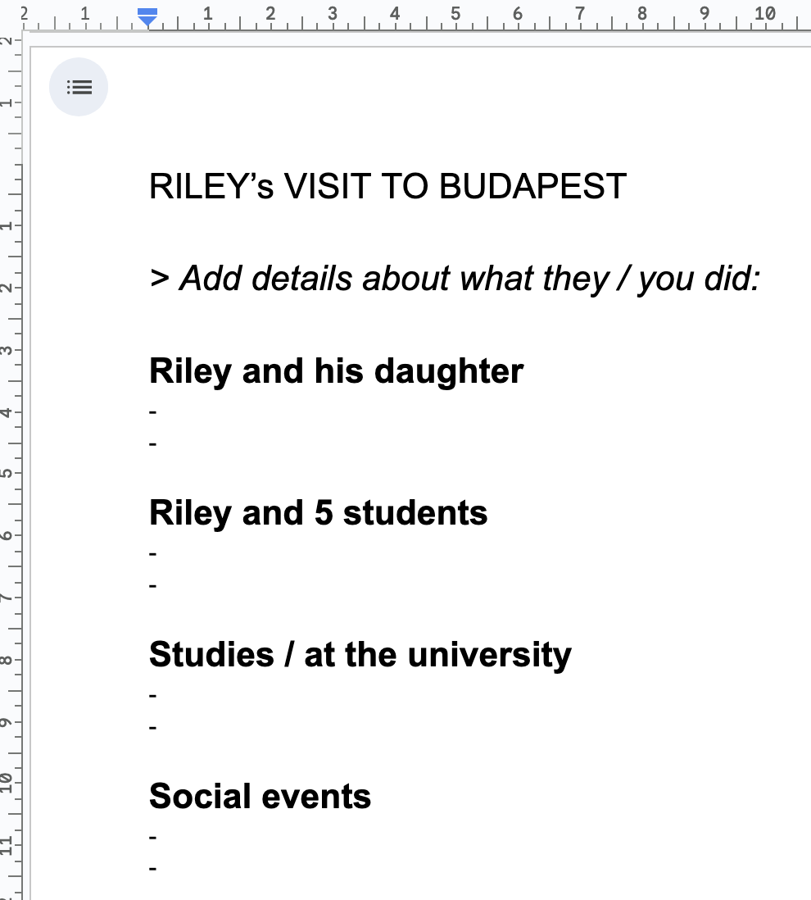
Ali – the lesson
Riley’s visit to Budapest
a US colleague + 5 students + daughter
in/formal events
[Cameras / mics. off 4’]
[prepositions] - I was __ work yesterday. - He works ___ home. - …

Slide 20
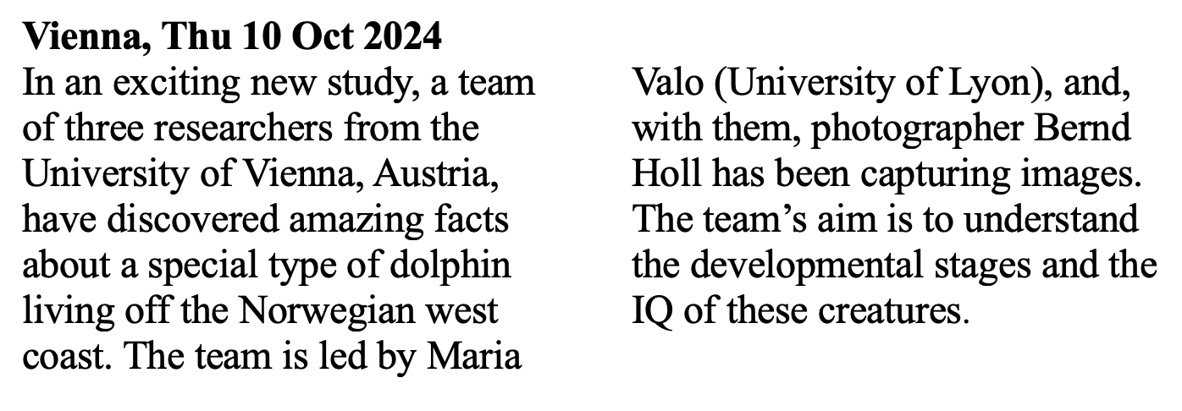
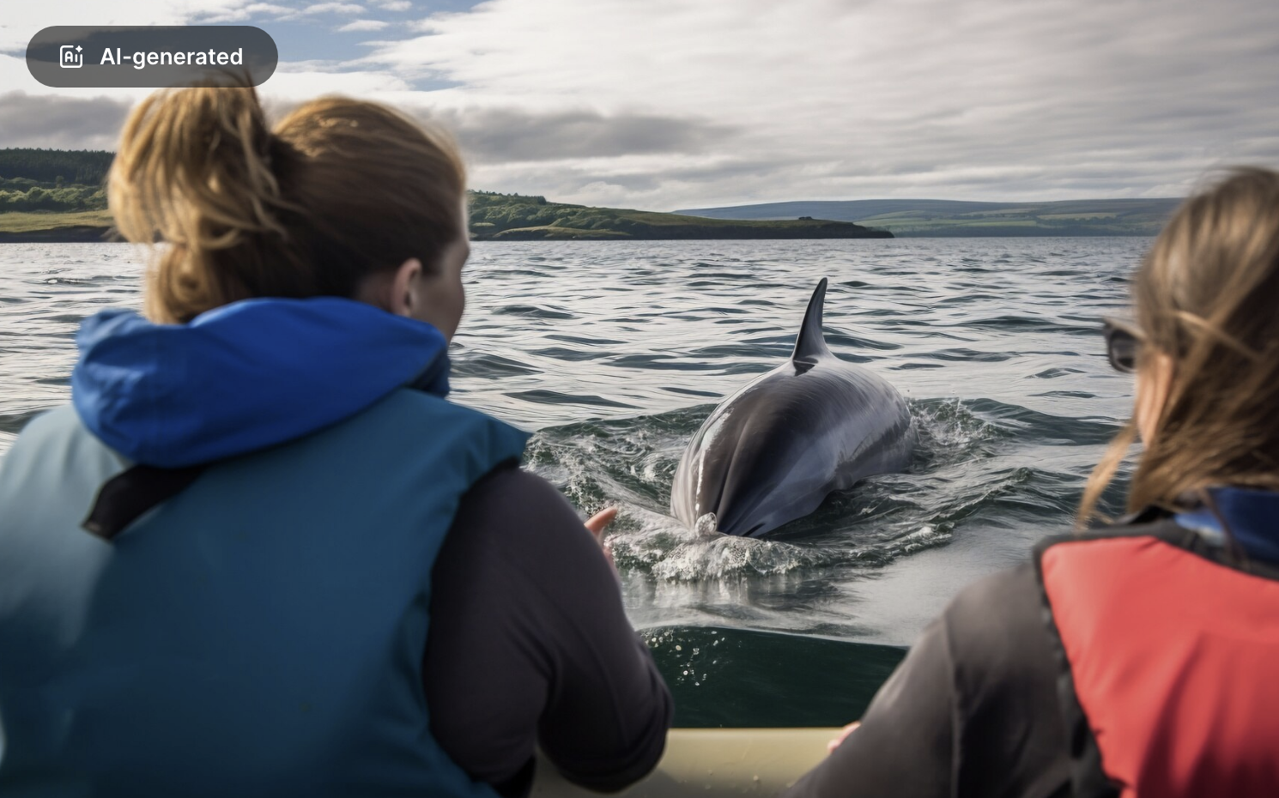
David – the lesson

Slide 21
David – the lesson
Vienna, Thu 10 Oct 2024 In an exciting new study, a team of (1) ……..….. researchers from the University of Vienna, (2) A……………, have discovered amazing facts about a special type of (3) d…………… living off the Norwegian west coast. The team is led by Maria Valo (University of Lyon), and, with them, (4) p…………..…. Bernd Holl has been capturing images. The team’s aim is to understand the (5) d…………………. stages and the (6) I…… of these creatures.

Slide 22
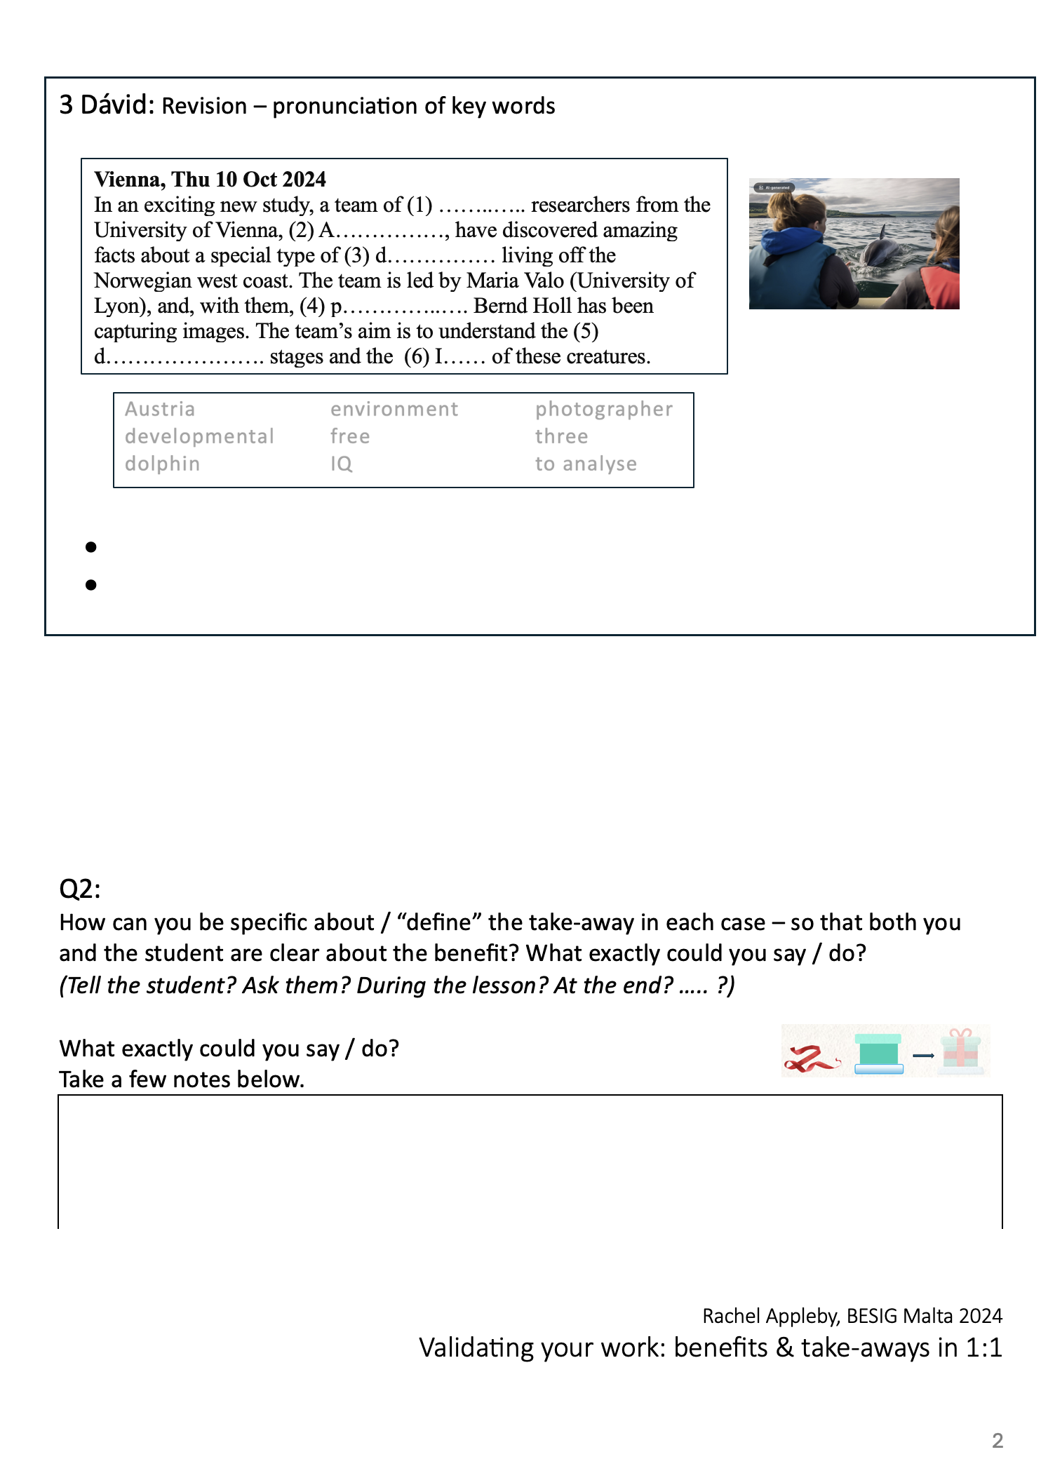
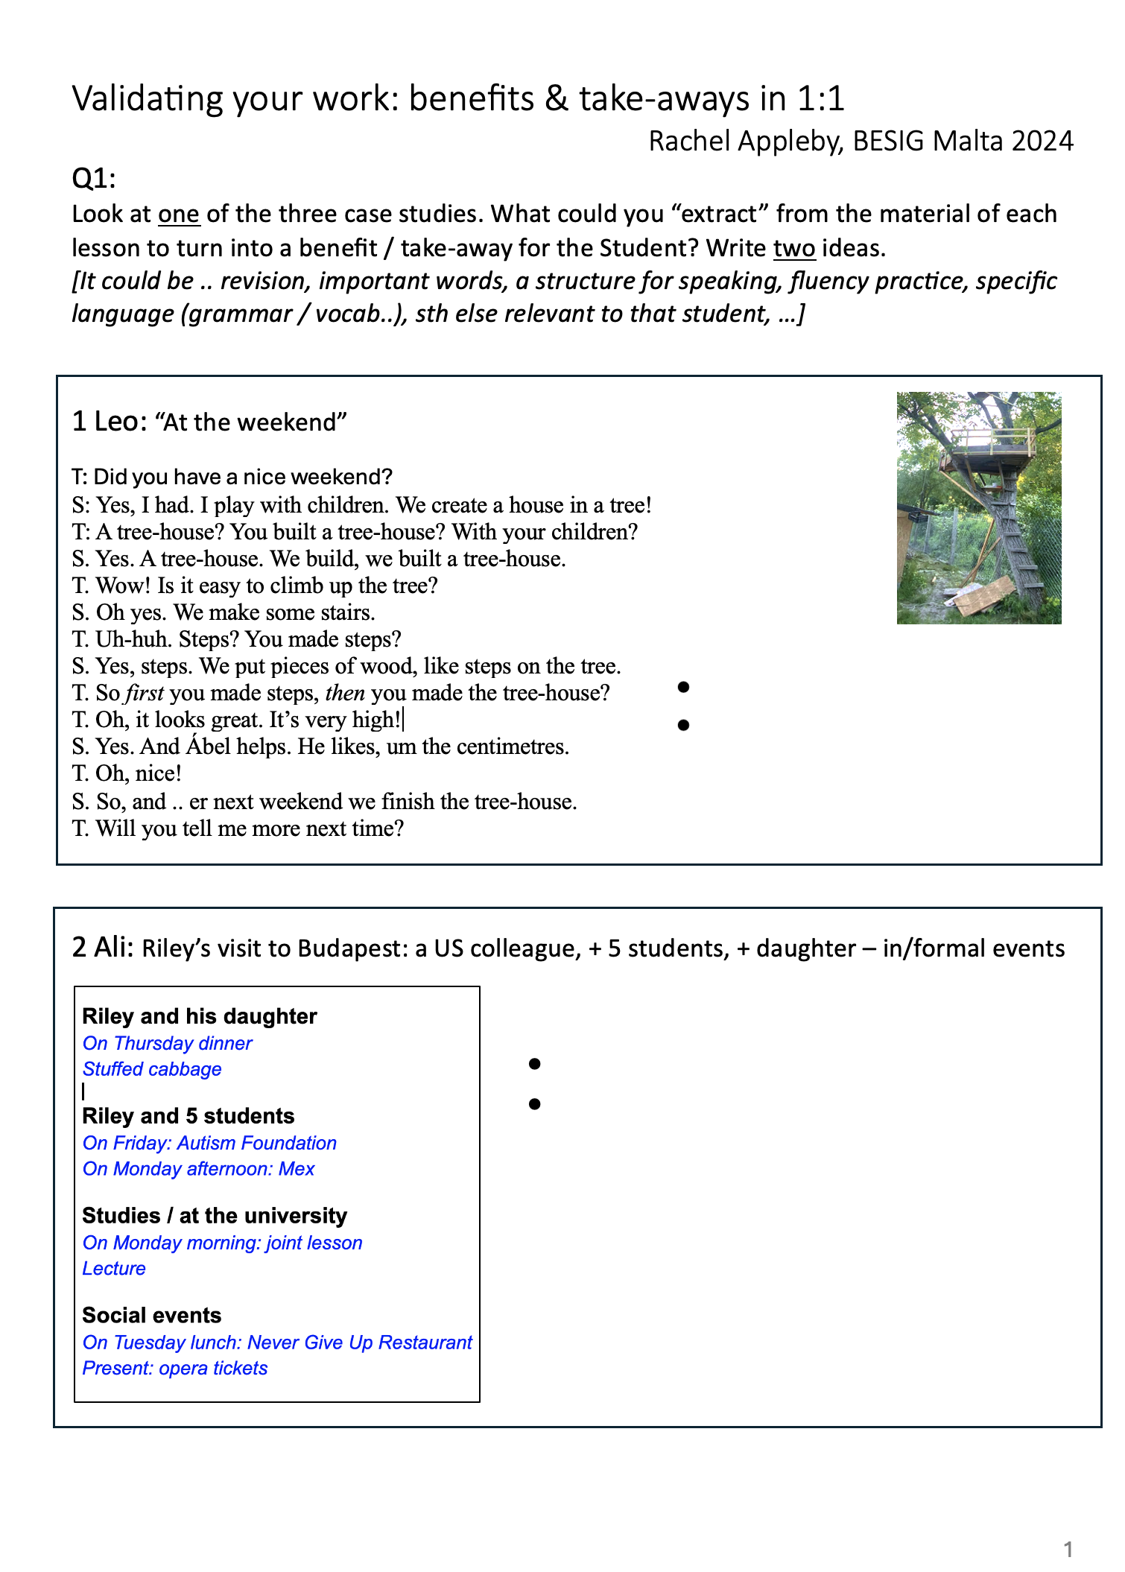
What take-away can you define?
💭

Slide 23
The Focus
The Take-away(s)
Questions
Reformulate
Tools / size / height
Processes (first, then.. )
Photos
Took notes > discussion
“Update me next week”
Talk about self / kids
Describe a process
Notes: 3-column feedback
Sth for next time

Slide 24
My notes
off-screen (columns 1+2)
Shared-screen – working on column 3

Slide 25
The Focus
The Take-away(s)
Made + shared Google doc
Asked to think/take notes
[Cameras/mics off: 4’; Camera on]
She talked through notes
Questions
I took notes (off screen)
Shared notes > discussion
Talking about own work / interests / event
Structure to talk
Ownership: editing rights
Notes: 3-column feedback
Sth for next time: check the notes, revise

Slide 26
The Focus
The Take-away(s)
9 words:
[mics. off] read words aloud
[mics. on] check pron
T+S read 1 word in turn(x2)
Use picture to elicit
Gapfill (w/o key words)
Complete text orally
Show key words > check
Share doc / editing rights:
S repeats ex. at home
Work-related topic
Confidence: pron – key words
(Ownership: editing rights given at the end)
Sth for next time: Try ex. again

Slide 27
Outcomes
• flexibility
• respect
• authenticity
Personalised
Relevant
Language work
Real-life skills
Increased confidence
Do-able tasks
?

Slide 28
So, does this validate our hard work?
DEFINE benefits & take-aways, e.g.
Highlight
Get feedback
When? How?

Slide 29
How can you define the take-away?
💭

Slide 30
Defining the take-away (1)
During / Towards the end of the lesson:
Tell the S: “This sounds better. "
Ask: "Was this useful / interesting ? Why / not? When can you use it?”
At the end:
Tell the S: “This looks very professional. This will help you / your audience…” “You sound more confident.” “That’s a great story. Tell me more next time!”
Ask: “Tell me one thing you liked / found interesting / can use straight away” “What would you like to do more / less of next time?”
After the lesson … /…

Slide 31
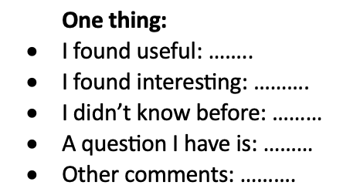
Defining the take-away (2)
on email / shared Google doc:
☹
à ?

Slide 32
Defining the take-away (3)
Who said what? Leo, Ali, David?
It’s very useful to check language from last time.
Guessing the topic of a story from words / a picture
Talking about my family ... then work things!
I liked that you were doing something else when I was writing on the Google doc.
I like pronunciation. I hate it when I speak and I’m not sure…
It helps that you take notes; I can think. I check them later.
The feedback, e.g. build = built
With pictures. To show and talk and check.
Time to think. Take notes. Then talk.

Slide 33
Defining the take-away (4)
on email / shared Google doc:

Slide 34
Recap: approach
• flexibility
• respect
• authenticity
Approach
Defining the take-away
(5-10’)

Slide 35
My 30-30-30 rule
• flexibility
• respect
• authenticity
Prepare 90% of what I might need
10%

Slide 36
Whatever your approach …
My 30+30+30+ rule
Define the take-away / benefit
Highlight / articulate it: – tell / ask the S.
Validate your work!
• flexibility
• respect
• authenticity

Slide 37
From this workshop:
💭
What’s your take-away?
What’s one thing you might try out next week?
… a different approach to preparing a 1:1 class?
… defining the take-away?
… highlighting it with your S?
# Tell someone!
# (tell me!)

Slide 38
Bibliography
Davies, B, (2016) ’Tales of the unexpected: the case for flexibility and anticipation in lesson planning’. ETP Issue 104
Hattie, J. (2012) Visible Learning for Teaching: Maximising Impact on Learning. Routledge
Rogers, C.R. & Freiberg, H.J. (1994). Freedom to learn (3rd Ed). Columbus, OH: Merrill/Macmillan.
Scrivener, J. (2009) Lesson Planning Handouts Qatar December 2009 PDF (www.teachingenglish.org.uk)
Scrivener, J. (1994) Learning Teaching, Macmillan.
Royalty-free images from: Pixabay, Freepik & PickPik

Slide 39
Validating your work: Benefits & take-aways in 1:1
Rachel Appleby
BESIG Malta, November 2024

